Slide 1
FX Investment Algorithm
Data Engineering Final Project
Group 7: Fengrui Li, Xingying Li, Zhuoqun Li, Banglin Liao

Slide 2
Project Summary
Goals: Making profit by investing currency pairs
Our Audience: CEO, Executives, Decision makers or Individual investors
Our Role: NYU Engineering Group brought to design an algorithm that helps with auto-investment of currencies
Data Source: Polygon
Tools: Python, MongoDB, Sqlite

Slide 3

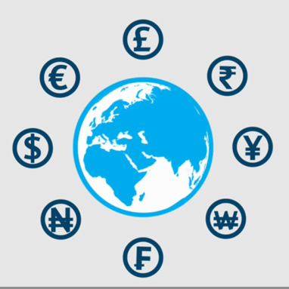
Project Steps
1.
Currency Pairs Identification
2.
Collection of Data
3.
Cleaning of Data
4.
Classification Models
CWT & Clustering
5.
6.
Prediction
Decisions & Recommendations
7.

Slide 4
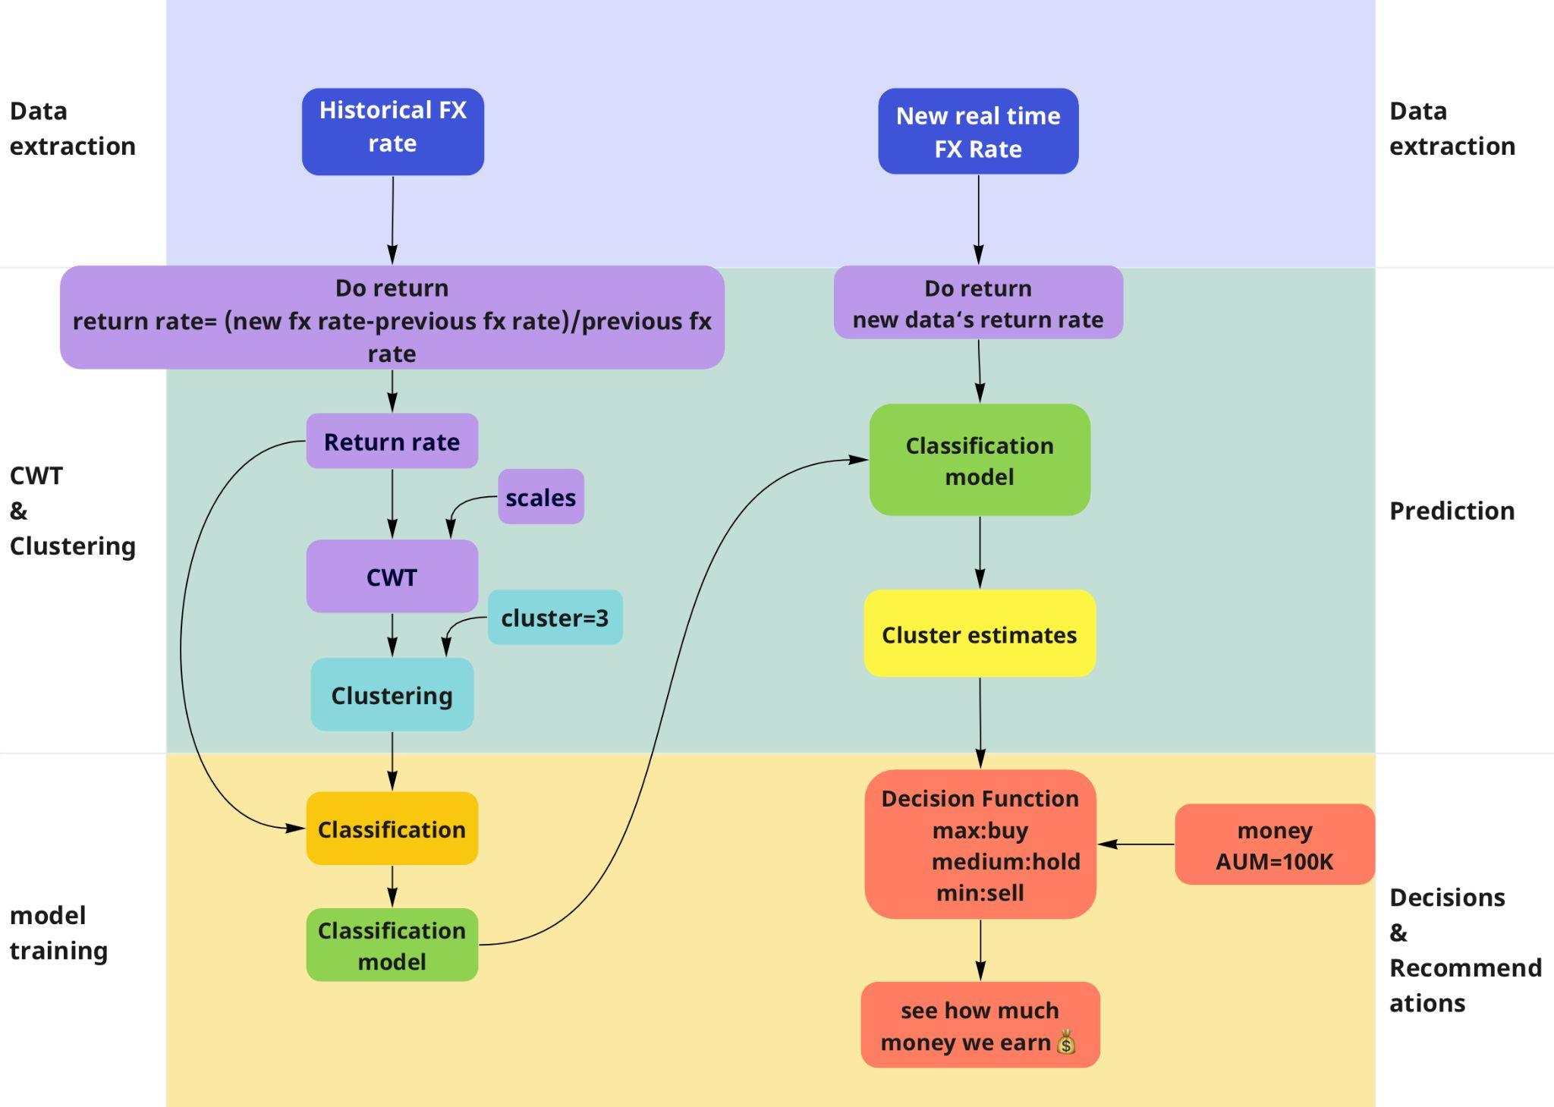
Logic Flow Chart

Slide 5
Product Intro & Data Preparation
P A R T 0 1
Automated Trading system & Financial Facts & product Introduction & Data Extraction

Slide 6
When it comes to looking for a broker that can adapt to your trading strategy, what you should pay attention to?

Slide 7
Automated Trading in the FX Market
The spot foreign exchange market has developed a lot since the beginning of 2000, in part due to the influx of algorithmic platforms.
Actually, trading platform EBS estimates as much as 70 percent of orders on its platform now originate from algorithms, whereas in 2004, all trading was undertaken by humans.

Slide 8
Types of Automated Trading
●Arbitrage
●High-Frequency Trading (HFT)
●Quant Trading

Slide 9
FX Quant Trading Challenges
●The lack of data in FX trading compared to stocks.
This is one of the main obstacles to implementing a quantitative trading strategy in Forex. Since the FX market is considered an OTC market and is not traded on centralized exchanges, there is little uniform data. ECN only publishes about 15% of the data, while the rest of the trades in the market are "black box operations".
●Many traders underestimate the cost of quality data.

Slide 10
What We Offer
●Model trained from high-quality data. We used a plethora of high-quality data obtained from Polygon, which supports Tick data for 16 U.S. stocks trading and Dark Pools trading.
●Adaptive reinforcement learning layer. We trained our data in multiple models, the optimist model with the highest accuracy results was chosen. The real-time data simulates trading also shows high return results.
●Risk management. We provide risk advice to each transaction.

Slide 11
What We Offer
Key Attributes & Foreign Exchange Rate
●Model trained from high-quality data.
●Adaptive reinforcement learning layer.
●Risk management.
●1 week, 6 pairs, per minute, 30000 data.
●80/20. Use original data to testify model accuracy.
●Soft method to forecast risks.

Slide 12
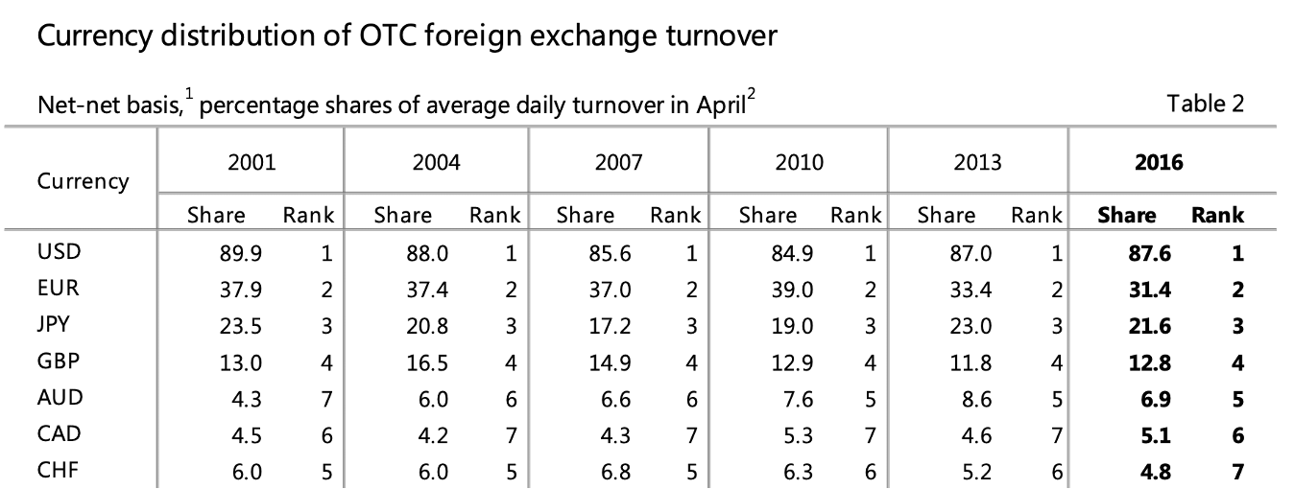
Data Extraction
FX Pairs Choosing
Bank for International Settlements

Slide 13
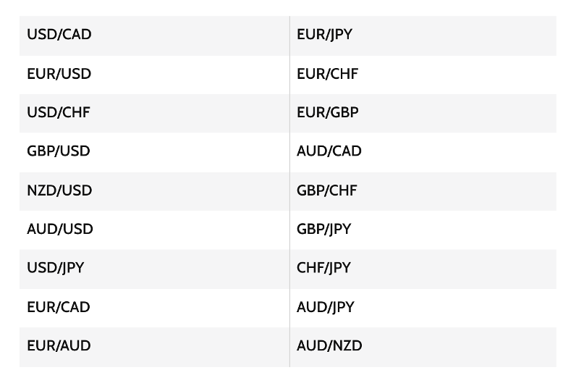
Data Extraction
FX Pairs Choosing
●https://www.investopedia.com/ask/answers/06/maincurrencypairs.asp

Slide 14
Data Extraction
FX Pairs Choosing
●GBPUSD 1.33
●EURUSD 1.13
●USDJPY 113.63
●USDCAD 1.28
●USDCHF 0.92
●AUDUSD 0.72
Dec 16, 8:45 PM UTC

Slide 15
Data Extraction
Polygon & API keys
INPUT
● timespan: time period unit
● multiplier: time period quantity
● from: start time
● to: end time
● currencies: Currency pairs used to test
● API Key: personal API Key

Slide 16
Data Extraction
Polygon & API keys
OUTPUT
● index: be resetted, start from 0 to 29999.
● timestamp: time period quantity
● currency_pair: start time
● fx_rate: end time
● date: date in yyyy-MM-dd HH:mm
● minute: date in minute

Slide 17
Data Organization & Storage
● Create MongoDB Library
● Store the data though Arctic
● read data
● compression data
Notes:
Switch to Python Notebook to show the code

Slide 18
What We Offer
Product Details
●Model trained from high-quality data.
●Adaptive reinforcement learning layer.
●Risk management.
●1 week, 6 pairs, per minutes, 30000 data.
●80/20. Use original data to testify model accuracy.
●Soft method to forecast risks.

Slide 19
Model Classification
P A R T 0 2
Which models we chose and how we trained them
Notes:
In this Section, we implemented classification models by inputting x and y.
we use calculated returns as x variables and cluster label as y variables.
Then we split the data into training and testing sets

Slide 20
Classification Models
Random Forest
Gradient Boosting
K-Nearest Neighbor
XGboost
Logistic Regression
Predicted Clusters
Notes:
Due to time limit, I will brief talk about the advantages of each model we used in the following parts

Slide 21
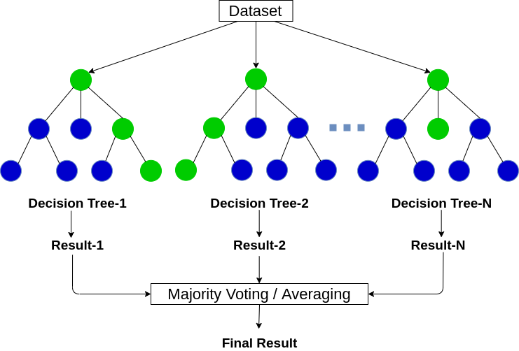
Random Forest
Tree Structure
High accuracy
Control over-fitting

Slide 22
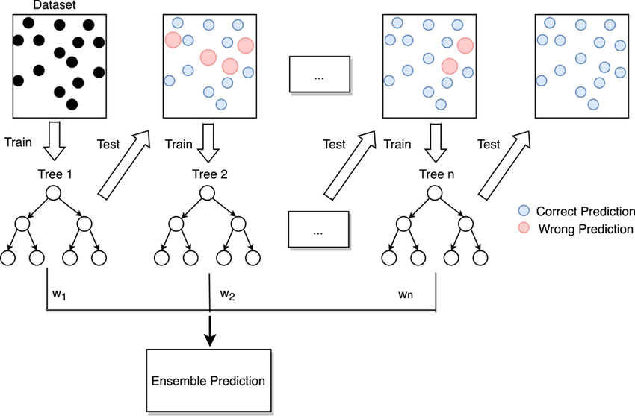
Gradient boosting
Tree Structure
Error Correction
Longer Time, but higher Accuracy

Slide 23
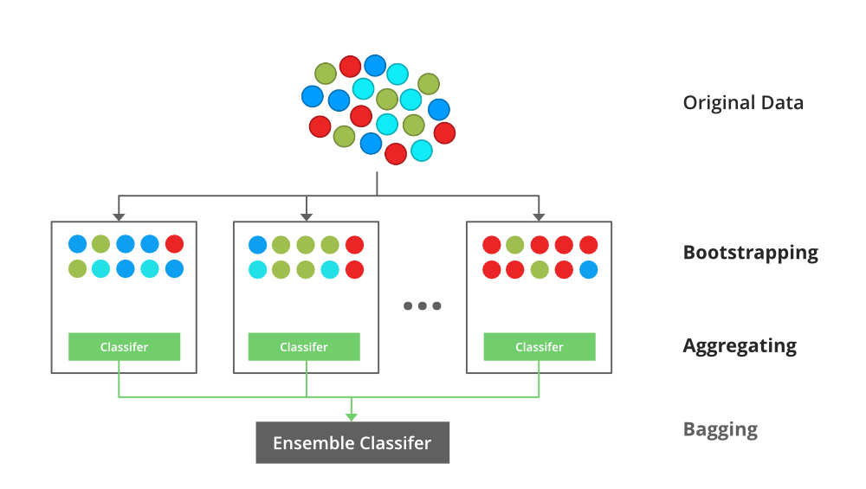
XGboost
Compatible for various forms of data sets
Shorter Training period

Slide 24
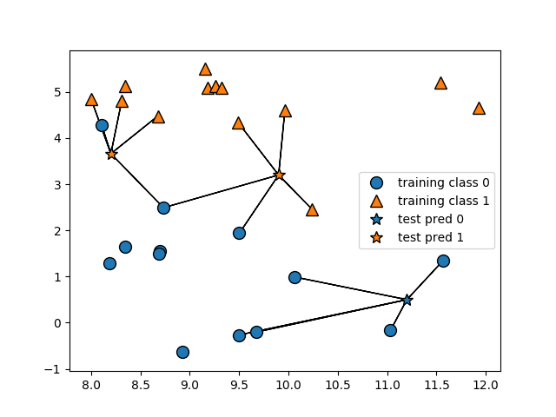
K-Nearest Neighbor
No Training Period
Faster than Logistic Regression
Easy to Implement

Slide 25
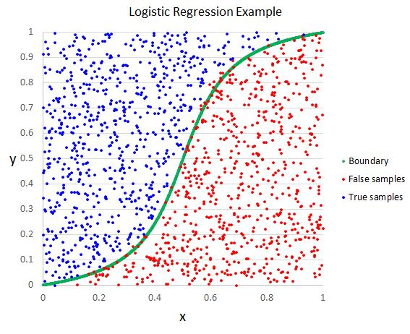
Logistic Regression
Easier to implement and efficient to train.
Easily extend to multiple classes(multinomial regression)
Less Inclined to Over Fitting

Slide 26
Parameter Tuning
Scales & Size of Dataset & Date
Adjusting Scales: np.arange(1,8,2) 2**np.arange(8)
Increasing Training Size: 4320 rows 30000 rows
Switching Dates: best prediction accuracy found from Oct.25th to Oct. 29th
Notes:
Switch to Python Notebook to show the code

Slide 27
Parameter Tuning
Split Size & Random State & Others
Large data Set Large training set & Smaller testing set
Random States:
Max-depth, N-estimators, Neighbors
20
15
10
8
6
Notes:
Switch to Python Notebook to show the code

Slide 28
Model Performance
Classification Report
Confusion Matrix
Accuracy Scores
Notes:
Switch to Python Notebook to show the output

Slide 29
Return & Clustering Analysis
P A R T 0 3
How we analyzed the returns and define clusters

Slide 30
Index Organization
Cut all new real-time FX Rate into dependent currency pair
Reset index: make sure each cluster has its own index
Prevent error return rate when calculating

Slide 31
Return Calculation
Return rate=(current value-last previous value)/last previous value
Code:
Return_result.append((signal.iloc[i] - signal.iloc[i - 1]) /signal.iloc[i - 1 ])

Slide 32
Continuous Wavelet
Transform(CWT )
Smooth data from ‘spiky’ pattern
scales = 2**np.arange(8) but too smooth? More Na values

Slide 33
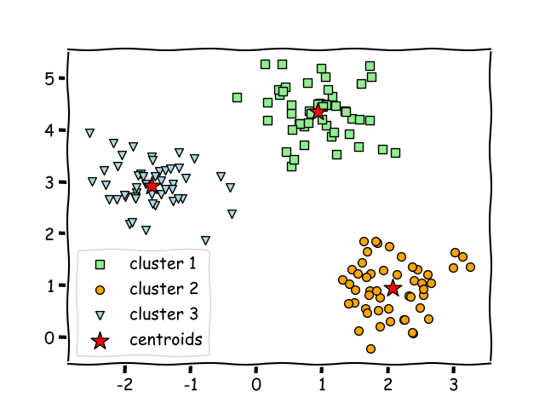
Clustering
Do sanity check fillna(0)
Set 3 clusters: buy; hold; sell
Generate boxplot to get its max & min value(Return Rate Mean)
Build a dictionary to match cluster number & decision cluster
Using machine learning algorithm to train a predict-classification model
BUY
HOLD
SELL

Slide 34
Decision Making & Conclusion
P A R T 0 4
How we make decisions and analyze the results

Slide 35
Real-Time Data
Obtain data from Polygon and compute return
Use return as signal to make decision and and order based on pre-calculated cluster
if decision == 'sell_cluster':
money += -buysell * Re[i]
elif decision == 'buy_cluster':
money += buysell * Re[i]

Slide 36
Model Performance
Evaluate performance based on return from testing
Accuracy, risk and speed are also taken into consideration
Logistics Regression model has better return in most currency pair, and Gradient Boosting has the lowest return for all currency pair with longer time needed

Slide 37
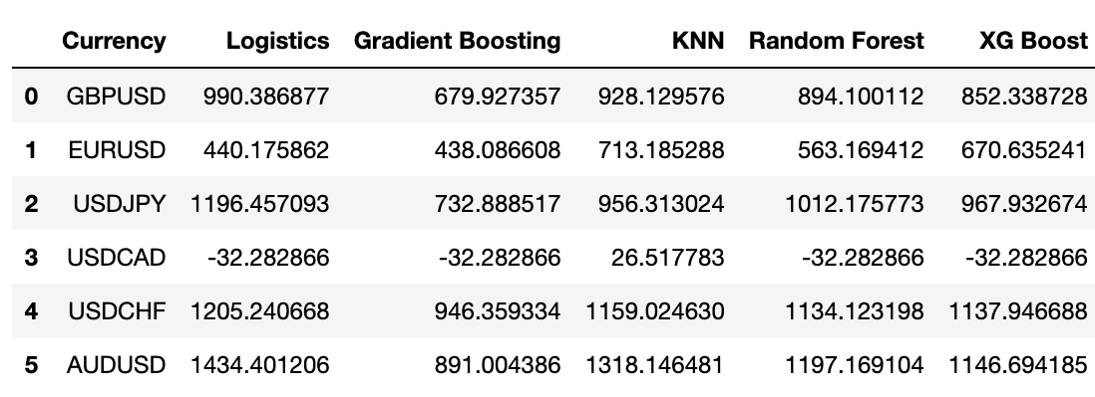
Currency Performance
AUD/USD and USD/CHF has much better overall performance across all models
Currency performance varies from different models used

Slide 38
Conclusion
Which model to use & which currency pairs to invest
One or more models could be used
In general, Logistic Regression could be used to generate better return for most currency pair
Multiple models could be used to achieve best return for specific currency pair
AUD/USD, USD/JPY and USD/CHF could be invested that has better return in all models

Slide 39
Thanks!

